Slide 1

Mathe III
Ralf Herbrich
Bayesianische Statistik

Slide 2
Overview
Bayesian Probabilities and Conjugacy
Graphical Models
The Sum-Product Algorithm
Bayesian Ranking: TrueSkill
Information Theory
Arithmetic Coding

Slide 3
Overview
Bayesian Probabilities and Conjugacy
Graphical Models
The Sum-Product Algorithm
Bayesian Ranking: TrueSkill
Information Theory
Arithmetic Coding

Slide 4

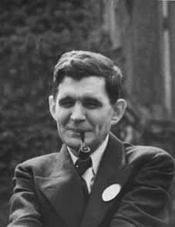
Frequentist vs. Subjective Probabilities
Kolmogorov (1933): The rules of probability for sets follow from the following 3 axioms
$P\left(A\right)≥0$ for all $A⊆S$
$P\left(S\right)=1$
$P\left(\bigcup_{i}{A_{i}}\right)=\sum_{i}{P\left(A_{i}\right)}$ if for all $i≠j:A_{i}∩A_{j}=∅$
Cox (1944): The rules of probability for logic follow from the following 3 axioms
$P\left(A\right)∈\left[0,1\right]$ for all logical statements $A$
$P\left(A\right)$ is independent of how the statement is represented
If $P\left(A|C^{′}\right)>P\left(A|C\right)$ and $P\left(B|A∧C^{′}\right)=P\left(B|A∧C\right)$ then
$$P\left(A∧B|C^{′}\right)≥P\left(A∧B|C\right)$$
Andrey Kolmogorov (1903 – 1987)
Richard Threlkeld Cox (1898 – 1991)

Slide 5
Frequentist vs. Subjectivist Interpretation
Frequentist Interpretation
Probability is a property of the event (“it rains tomorrow in Bangalore”)
Is operationalized by repeated experiments
Typically used by scientists and engineers
Subjective Interpretation
Probability is an expression of belief of the person makes a statement
Is subjective and people-dependent: Two people with identical data can come to different probabilities
Typically used by philosophers and economists
Probability is not a physical measure but a thought model for randomness!
The mathematical rules for probability are identical for both interpretations!

Slide 6
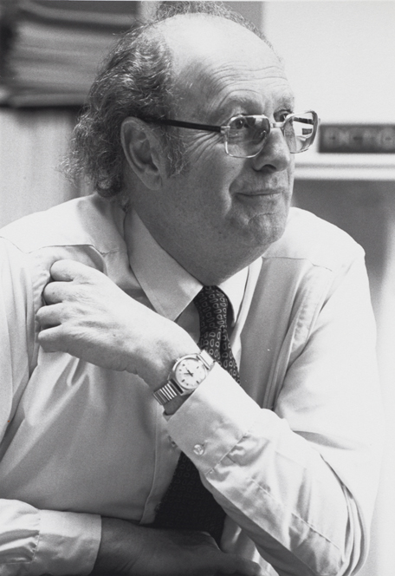
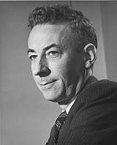
Probability Distributions: Conjugacy
Bayes Rule for Random Variables. For any probability distribution $p$ over two random variables $X$ and $Θ$, it holds
$$p\left(θ|x\right)=\frac{p\left(x|θ\right)⋅p\left(θ\right)}{p\left(x\right)}$$
Conjugacy. A family ${\left\{p\left(x,θ\right)\right\}}_{x,θ}$ is conjugate if the posterior $p\left(θ|x\right)$ is part of the same family as the prior $p\left(θ\right)$ for any value of $x$.
Big Advantage: Computing the exact posterior is computationally efficient!
Likelihood
$$p\left(x,θ\right)$$
Howard Raiffa (1924 – 2016)
Posterior
Prior
Likelihood $p(x|θ)$ | Model Parameter | Conjugate Prior $p(θ)$
$$Ber\left(x;π\right)$$ | $$π$$ | $$Beta\left(π;α,β\right)$$
$$Bin\left(x;n,π\right)$$ | $$π$$ | $$Beta\left(π;α,β\right)$$
$$𝒩\left(x;μ,σ^{2}\right)$$ | $$μ,σ^{2}$$ | $$𝒩\left(μ;m,s^{2}\right)$$
Robert Osher Schlaifer (1914 – 1994)

Slide 7
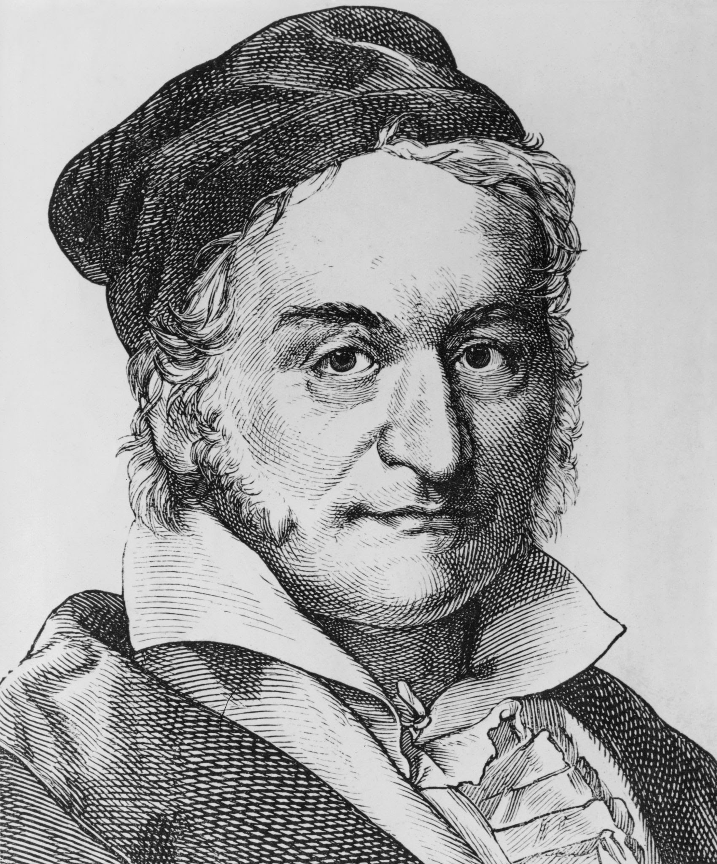
Probability Distributions: Normal
Normal Distribution. A continuous random variable $X$ is said to have a normal distribution if the density is given by
$$p_{X}\left(x;μ,σ^{2}\right)=\frac{1}{\sqrt{2π}σ}\exp\left(−\frac{{\left(x−μ\right)}^{2}}{2σ^{2}}\right)$$
Properties:
$$E\left[X\right]=μ$$
$$var\left[X\right]=σ^{2}$$
Importance. The Normal distribution plays a fundamental role in ML!
Data Modelling: The limit distribution for the sum of a large number of indepedent and identically distributed random variables.
Machine Learning: The most common prior distribution for the parameters of prediction functions!
Information Theory: The distribution function with the most uncertainty (“entropy”) when fixing mean and variance of the random variable.
Carl Friedrich Gauss (1777 - 1855)

Slide 8
Normal Distribution: Representations
Two Parameterizations (for different purposes):
Scale-Location Parameters
$$𝒩\left(x;μ,σ^{2}\right)=\frac{1}{\sqrt{2π}σ}\exp\left(−\frac{{\left(x−μ\right)}^{2}}{2σ^{2}}\right)$$
Natural Parameters
$$𝒢\left(x;τ,ρ\right)=\sqrt{\frac{ρ}{2π}}⋅\exp\left(−\frac{τ^{2}}{2ρ}\right)⋅\exp\left(τ⋅x−ρ⋅\frac{x^{2}}{2}\right)$$
Conversions
$$𝒩\left(x;μ,σ^{2}\right)=𝒢\left(x;\frac{μ}{σ^{2}},\frac{1}{σ^{2}}\right). 𝒢\left(x;τ,ρ\right)=𝒩\left(x;\frac{τ}{ρ},\frac{1}{ρ}\right)$$
Two Special Cases
Constant function: $c\left(x\right)=1=\exp\left(0\right)=\lim_{σ^{2}→∞}{\exp\left(−\frac{x^{2}}{σ^{2}}\right)=\frac{𝒢\left(x;0,0\right)}{𝒩\left(0;0,0\right)}}$
Dirac Delta: $δ\left(x\right)=\lim_{σ^{2}→0}𝒩\left(x;0,σ^{2}\right)$
Two divisions only!

Slide 9
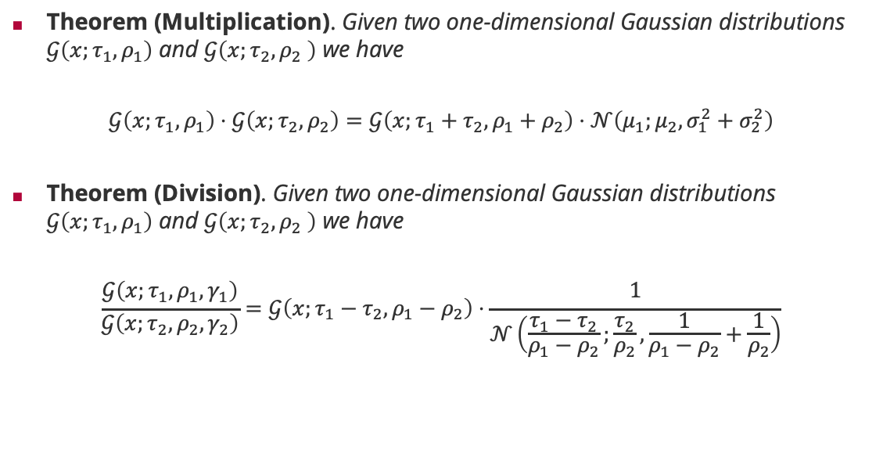
Normal Distributions and the Product Rule
Theorem (Multiplication). Given two one-dimensional Gaussian distributions $𝒢\left(x;τ_{1},ρ_{1}\right)$ and $𝒢\left(x;τ_{2},ρ_{2} \right)$ we have
$$𝒢\left(x;τ_{1},ρ_{1}\right)⋅𝒢\left(x;τ_{2},ρ_{2}\right)=𝒢\left(x;τ_{1}+τ_{2},ρ_{1}+ρ_{2}\right)⋅𝒩\left(μ_{1};μ_{2},σ_{1}^{2}+σ_{2}^{2}\right)$$
Theorem (Division). Given two one-dimensional Gaussian distributions $𝒢\left(x;τ_{1},ρ_{1}\right)$ and $𝒢\left(x;τ_{2},ρ_{2} \right)$ we have
$$\frac{𝒢\left(x;τ_{1},ρ_{1},γ_{1}\right)}{𝒢\left(x;τ_{2},ρ_{2},γ_{2}\right)}=𝒢\left(x;τ_{1}−τ_{2},ρ_{1}−ρ_{2}\right)⋅\frac{1}{𝒩\left(\frac{τ_{1}−τ_{2}}{ρ_{1}−ρ_{2}};\frac{τ_{2}}{ρ_{2}},\frac{1}{ρ_{1}−ρ_{2}}+\frac{1}{ρ_{2}}\right)}$$
Gaussian density
Additive updates!
Gaussian density
Subtractive updates!

Slide 10
Overview
Bayesian Probabilities and Conjugacy
Graphical Models
The Sum-Product Algorithm
Bayesian Ranking: TrueSkill
Information Theory
Arithmetic Coding

Slide 11
Graphical Models
Challenge: How to formulate complex likelihoods/data models & priors for actual data?
Example 1: Match outcomes $y∈\left\{−1,1\right\}$ for a head-to-head match between two players
Prior: $p\left(s\right)=𝒩\left(s_{1};μ_{1},σ_{1}^{2}\right)⋅𝒩\left(s_{2};μ_{2},σ_{2}^{2}\right)$
Likelihood: $p\left(y|s\right)=\int{𝒩\left(p_{1};s_{1},β^{2}\right)⋅𝒩\left(p_{2};s_{2},β^{2}\right)⋅𝕀\left(y\left(p_{1}−p_{2}\right)>0\right) dp_{1} dp_{2}}$
Example 2: Time series $y$ of temperatures given
Prior: $p\left(w\right)=𝒩\left(w;μ,σ^{2}\right)$
Likelihood: $p\left(y|w,X\right)=\int{𝒩\left(z_{1}; w⋅x_{1},τ^{2}\right)⋅𝒩\left(y_{1};z_{1},β^{2}\right)⋅𝒩\left(z_{2};z_{1}+w⋅x_{2},τ^{2}\right)⋯ dz}$
skill belief
marginalization
Match outcome
Player performance
External state mapping parameter belief
marginalization
Dynamics model
Observed temperature model
Conditional hidden state model

Slide 12
Graphical Models
Observation: The product structure of the probabilities seems crucial!
Idea: Define a graph where each of the variables are nodes and edges indicate relationships between variables
Advantages: Simple way to visualize factor structure of the joint probability
Bayesian Networks: Insights into (conditional) independence based on graph properties
Factor Graphs: Insights into efficient inference and approximation algorithms
$$𝒩\left(s_{1};μ_{1},σ_{1}^{2}\right)⋅𝒩\left(s_{2};μ_{2},σ_{2}^{2}\right)⋅𝒩\left(p_{1};s_{1},β^{2}\right)⋅𝒩\left(p_{2};s_{2},β^{2}\right)⋅𝕀\left(y\left(p_{1}−p_{2}\right)>0\right)$$
$$𝒩\left(w;μ,σ^{2}\right)⋅𝒩\left(z_{1}; w⋅x_{1},τ^{2}\right)⋅𝒩\left(y_{1};z_{1},β^{2}\right)⋅𝒩\left(z_{2};z_{1}+w⋅x_{2},τ^{2}\right)⋅𝒩\left(y_{2};z_{2},β^{2}\right)⋯$$
$$s_{1}$$
$$s_{2}$$
$$x_{1}$$
$$x_{2}$$
$$x_{3}$$
$$p_{1}$$
$$p_{2}$$
$$w$$
$$z_{1}$$
$$z_{2}$$
$$z_{3}$$
$$y$$
$$y_{1}$$
$$y_{2}$$
$$y_{3}$$

Slide 13
Bayesian Networks
Observation. Any joint distribution $p\left(x_{1},…,x_{n}\right)$ can be written as
$$p\left(x_{1},…,x_{n}\right)=\prod_{i=1}^{n}{p\left(x_{i}|x_{1},…,x_{i−1}\right)}$$
Bayesian Network. Given a joint distribution as a product of conditional distributions, $p\left(x_{1},…,x_{n}\right)=\prod_{i=1}^{n}{p\left(x_{i}|{parents}_{i}\right)}$, a Bayesian network is a graph with a node for every variable $x_{i}$, and a directed from every variable $x∈{parent}_{i}$ to $x_{i}$. If the variable is independent of all other variables, it has no incoming edges.
Examples: For 3 variables, we have these four generic Bayesian networks
$$x_{1}$$
$$x_{2}$$
$$x_{1}$$
$$x_{2}$$
$$x_{1}$$
$$x_{2}$$
$$x_{1}$$
$$x_{2}$$
$$x_{3}$$
$$x_{3}$$
$$x_{3}$$
$$x_{3}$$
$$p\left(x_{1},x_{2},x_{3}\right)=p\left(x_{1}\right)⋅p\left(x_{2}|x_{1}\right)⋅p\left(x_{3}|x_{1},x_{2}\right)$$
$$p\left(x_{1},x_{2},x_{3}\right)=p\left(x_{1}\right)⋅\prod_{i=2}^{3}{p\left(x_{i}|x_{1}\right)}$$
$$p\left(x_{1},x_{2},x_{3}\right)=p\left(x_{1}\right)⋅\prod_{i=2}^{3}{p\left(x_{i}|x_{i−1}\right)}$$
$$p\left(x_{1},x_{2},x_{3}\right)=p\left(x_{3}|x_{1},x_{2}\right)⋅\prod_{i=1}^{2}{p\left(x_{i}\right)}$$
full mesh
star
chain
sink

Slide 14
Bayesian Network Models
$$p\left(x_{1},x_{2},x_{3}\right)=p\left(x_{1}\right)⋅\prod_{i=2}^{n}{p\left(x_{i}|x_{1}\right)}$$
Plates. If a subset of variables has the same relation only differing in their index, we use a ”plate” to collapse them into a single graphical element.
Increase readability of models for large amounts of parameters and data
A Bayesian network must always be a directed acyclic graph because only those have a topological order corresponding to a variable order.
Observed Variables. If a subset of variables has been observed (“data”), the variable nodes are usually shaded (“clamped”)
Examples:
$$x_{1}$$
$$i=2,…,n$$
$$x_{i}$$
Linear Regression
Linear Classification
$$w$$
$$w$$
$$i=1,…,n$$
$$i=1,…,n$$
$x_{i}$
$$y_{i}$$
$x_{i}$
$$t_{i}$$
$$y_{i}$$

Slide 15
Overview
Bayesian Probabilities and Conjugacy
Graphical Models
The Sum-Product Algorithm
Bayesian Ranking: TrueSkill
Information Theory
Arithmetic Coding

Slide 16



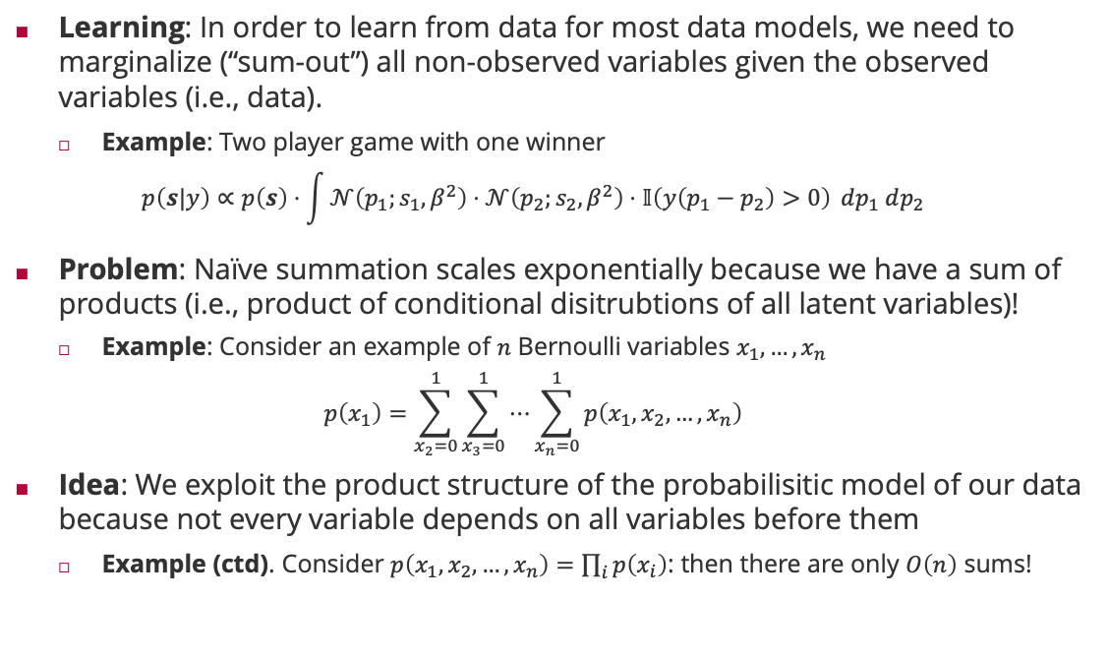



Inference in Probabilistic Models
Learning: In order to learn from data for most data models, we need to marginalize (“sum-out”) all non-observed variables given the observed variables (i.e., data).
Example: Two player game with one winner
$$p\left(s|y\right)∝p\left(s\right)⋅\int{𝒩\left(p_{1};s_{1},β^{2}\right)⋅𝒩\left(p_{2};s_{2},β^{2}\right)⋅𝕀\left(y\left(p_{1}−p_{2}\right)>0\right)} dp_{1} dp_{2}$$
Problem: Naïve summation scales exponentially because we have a sum of products (i.e., product of conditional disitrubtions of all latent variables)!
Example: Consider an example of $n$ Bernoulli variables $x_{1},…,x_{n}$
$$p\left(x_{1}\right)=\sum_{x_{2}=0}^{1}{\sum_{x_{3}=0}^{1}{⋯\sum_{x_{n}=0}^{1}{p\left(x_{1},x_{2},…,x_{n}\right)}}}$$
Idea: We exploit the product structure of the probabilisitic model of our data because not every variable depends on all variables before them
Example (ctd). Consider $p\left(x_{1},x_{2},…,x_{n}\right)=\prod_{i}{p\left(x_{i}\right)}$: then there are only $O\left(n\right)$ sums!
$$s_{1}$$
$$s_{2}$$
$$p_{1}$$
$$p_{2}$$
$$y$$
$2^{n−1}$ summations

Slide 17





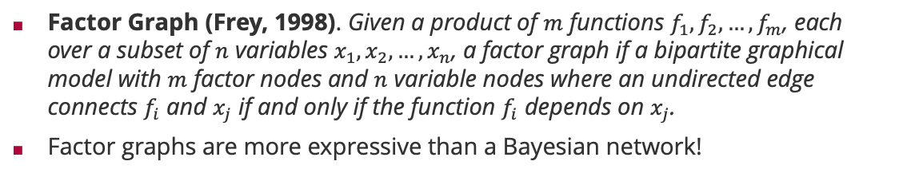








Factor Graphs
Factor Graph (Frey, 1998). Given a product of $m$ functions $f_{1},f_{2},…,f_{m}$, each over a subset of $n$ variables $x_{1},x_{2},…,x_{n}$, a factor graph if a bipartite graphical model with $m$ factor nodes and $n$ variable nodes where an undirected edge connects $f_{i}$ and $x_{j}$ if and only if the function $f_{i}$ depends on $x_{j}$.
Factor graphs are more expressive than a Bayesian network!
Brendan Frey (1968 – )
Bayesian network
Corresponding factor graph
Factor graph with more structure
$$x_{1}$$
$$x_{2}$$
$$x_{1}$$
$$x_{2}$$
$$x_{1}$$
$$x_{2}$$
$$x_{3}$$
$$x_{3}$$
$$x_{3}$$
$$p\left(x_{1},x_{2},x_{3}\right)=p\left(x_{1}\right)⋅p\left(x_{2}\right)⋅p\left(x_{3}|x_{1},x_{2}\right)$$
$$p\left(x_{1},x_{2},x_{3}\right)=f_{1}\left(x_{1}\right)⋅f_{2}\left(x_{2}\right)⋅f_{3}\left(x_{3},x_{1},x_{2}\right)$$
$$p\left(x_{1},x_{2},x_{3}\right)=f_{1}\left(x_{1}\right)⋅f_{2}\left(x_{2}\right)⋅f_{3}\left(x_{1},x_{3}\right)⋅f_{4}\left(x_{2},x_{3}\right)$$
Structure in $p\left(x_{3}|x_{1},x_{2}\right)$

Slide 18





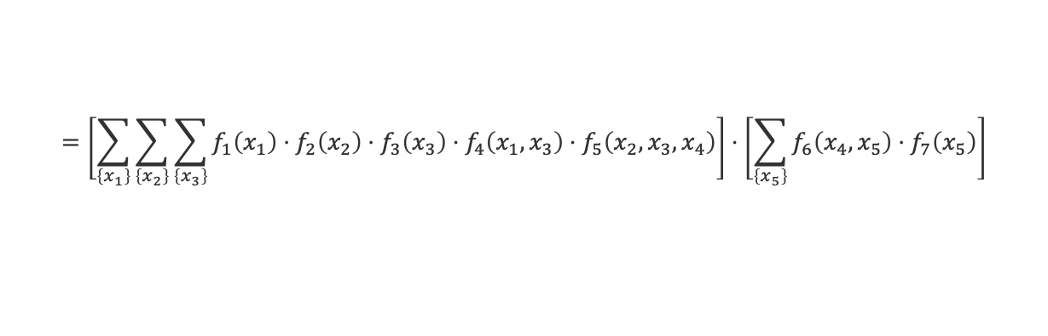



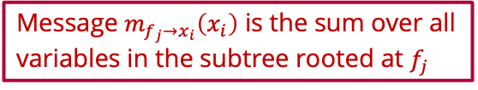









Sum-Product Algorithm: Marginals
$$f_{3}$$
$$f_{1}$$
$$f_{4}$$
$$x_{3}$$
$$x_{1}$$
$$f_{5}$$
$$f_{6}$$
$$f_{7}$$
$$x_{4}$$
$$x_{5}$$
$$f_{2}$$
$$m_{f_{5}→x_{4}}\left(x_{4}\right)$$
$$m_{f_{6}→x_{4}}\left(x_{4}\right)$$
$$x_{2}$$
Message $m_{f_{j}→x_{i}}\left(x_{i}\right)$ is the sum over all variables in the subtree rooted at $f_{j}$
$$p\left(x_{4}\right)=\sum_{\left\{x_{1}\right\}}{\sum_{\left\{x_{2}\right\}}{\sum_{\left\{x_{3}\right\}}{\sum_{\left\{x_{5}\right\}}{f_{1}\left(x_{1}\right)⋅f_{2}\left(x_{2}\right)⋅f_{3}\left(x_{2}\right)⋅f_{4}\left(x_{1},x_{3}\right)⋅f_{5}\left(x_{2},x_{3},x_{4}\right)⋅f_{6}\left(x_{4},x_{5}\right)⋅f_{7}\left(x_{5}\right)}}}}$$
$$=\left[\sum_{\left\{x_{1}\right\}}{\sum_{\left\{x_{2}\right\}}{\sum_{\left\{x_{3}\right\}}{f_{1}\left(x_{1}\right)⋅f_{2}\left(x_{2}\right)⋅f_{3}\left(x_{3}\right)⋅f_{4}\left(x_{1},x_{3}\right)⋅f_{5}\left(x_{2},x_{3},x_{4}\right)}}}\right]⋅\left[\sum_{\left\{x_{5}\right\}}{f_{6}\left(x_{4},x_{5}\right)⋅f_{7}\left(x_{5}\right)}\right]$$
$$m_{f_{5}→x_{4}}\left(x_{4}\right)$$
$$m_{f_{6}→x_{4}}\left(x_{4}\right)$$
Marginals are the product of all incoming messages from neighbouring factors!

Slide 19

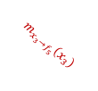
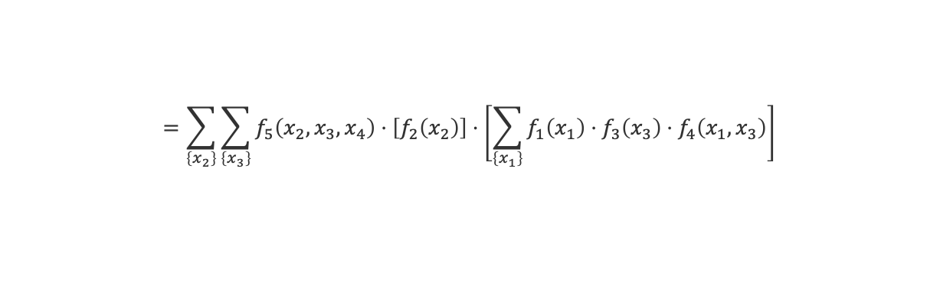

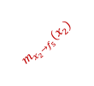





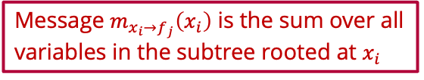
Sum-Product Algorithm: Message from Factor to Variable
$$f_{3}$$
$$f_{1}$$
$$f_{4}$$
$$x_{3}$$
$$m_{x_{3}→f_{5}}\left(x_{3}\right)$$
$$x_{1}$$
$$f_{5}$$
$$f_{6}$$
$$f_{7}$$
$$x_{4}$$
$$x_{5}$$
$$f_{2}$$
$$m_{f_{5}→x_{4}}\left(x_{4}\right)$$
$$m_{f_{6}→x_{4}}\left(x_{4}\right)$$
$$x_{2}$$
$$m_{x_{2}→f_{5}}\left(x_{2}\right)$$
Message $m_{x_{i}→f_{j}}\left(x_{i}\right)$ is the sum over all variables in the subtree rooted at $x_{i}$
$$m_{f_{5}→x_{4}}\left(x_{4}\right)=\sum_{\left\{x_{1}\right\}}{\sum_{\left\{x_{2}\right\}}{\sum_{\left\{x_{3}\right\}}{f_{1}\left(x_{1}\right)⋅f_{2}\left(x_{2}\right)⋅f_{3}\left(x_{3}\right)⋅f_{4}\left(x_{1},x_{3}\right)⋅f_{5}\left(x_{2},x_{3},x_{4}\right)}}}$$
$$=\sum_{\left\{x_{2}\right\}}{\sum_{\left\{x_{3}\right\}}{f_{5}\left(x_{2},x_{3},x_{4}\right)⋅\left[f_{2}\left(x_{2}\right)\right]⋅\left[\sum_{\left\{x_{1}\right\}}{f_{1}\left(x_{1}\right)⋅f_{3}\left(x_{3}\right)⋅f_{4}\left(x_{1},x_{3}\right)}\right]}}$$
$$m_{x_{2}→f_{5}}\left(x_{2}\right)$$
$$m_{x_{3}→f_{5}}\left(x_{3}\right)$$
Messages from a factor to a variable sum out all neighboring variables weighted by their incoming message

Slide 20




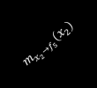






Sum-Product Algorithm: Message from Variable to Factor
$$f_{3}$$
$$m_{f_{3}→x_{3}}\left(x_{3}\right)$$
$$f_{1}$$
$$f_{4}$$
$$x_{3}$$
$$m_{x_{3}→f_{5}}\left(x_{3}\right)$$
$$x_{1}$$
$$f_{5}$$
$$f_{6}$$
$$f_{7}$$
$$m_{f_{4}→x_{3}}\left(x_{3}\right)$$
$$x_{4}$$
$$x_{5}$$
$$f_{2}$$
$$m_{f_{5}→x_{4}}\left(x_{4}\right)$$
$$m_{f_{6}→x_{4}}\left(x_{4}\right)$$
$$x_{2}$$
$$m_{x_{2}→f_{5}}\left(x_{2}\right)$$
$$m_{x_{3}→f_{5}}\left(x_{3}\right)=\sum_{\left\{x_{1}\right\}}{f_{1}\left(x_{1}\right)⋅f_{3}\left(x_{3}\right)⋅f_{4}\left(x_{1},x_{3}\right)}$$
$$=\left[f_{3}\left(x_{3}\right)\right]⋅\left[\sum_{\left\{x_{1}\right\}}{f_{1}\left(x_{1}\right)⋅f_{4}\left(x_{1},x_{3}\right)}\right]$$
$$m_{f_{3}→x_{3}}\left(x_{3}\right)$$
$$m_{f_{4}→x_{3}}\left(x_{3}\right)$$
Messages from a variable to a factor multiply incoming message from neighboring factors

Slide 21


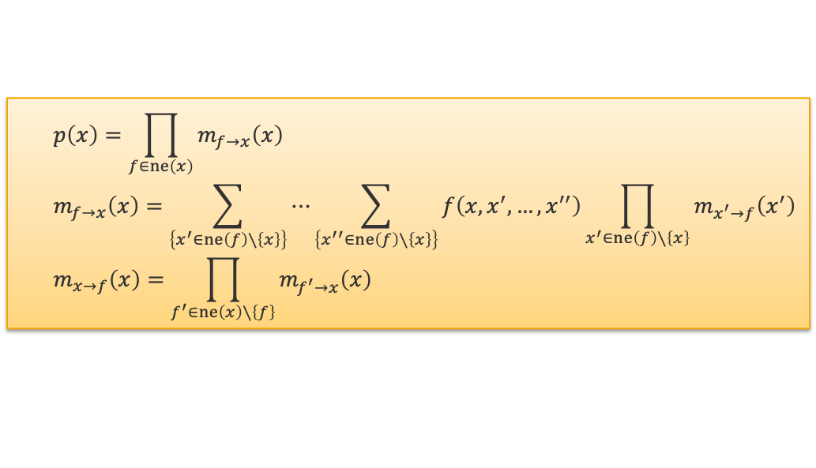
Sum-Product Algorithm
Sum-Product Algorithm (Aji-McEliece, 1997). Putting it all together, we have
Basis: Generalized distributive law (which also holds for max-product)
Efficiency: By storing messages, we
Only have to compute local summations in $O\left(2^{T}\right)$ where degree $T=\max_{f}\left|ne\left(f\right)\right|$!
All marginals can be computed recursively in $O\left(E⋅2^{T}\right)$ vs $O\left(2^{n}\right)$!
$$p\left(x\right)=\prod_{f∈ne\left(x\right)}{m_{f→x}\left(x\right)}$$
$$m_{f→x}\left(x\right)=\sum_{\left\{x^{′}∈ne\left(f\right)∖\left\{x\right\}\right\}}{⋯\sum_{\left\{x^{′′}∈ne\left(f\right)∖\left\{x\right\}\right\}}{f\left(x,x^{′},…,x^{′′}\right)\prod_{x^{′}∈ne\left(f\right)∖\left\{x\right\}}{m_{x^{′}→f}\left(x^{′}\right)}}}$$
$$m_{x→f}\left(x\right)=\prod_{f^{′}∈ne\left(x\right)∖\left\{f\right\}}{m_{f^{′}→x}\left(x\right)}$$
Robert McEliece (1942 – 2019)

Slide 22

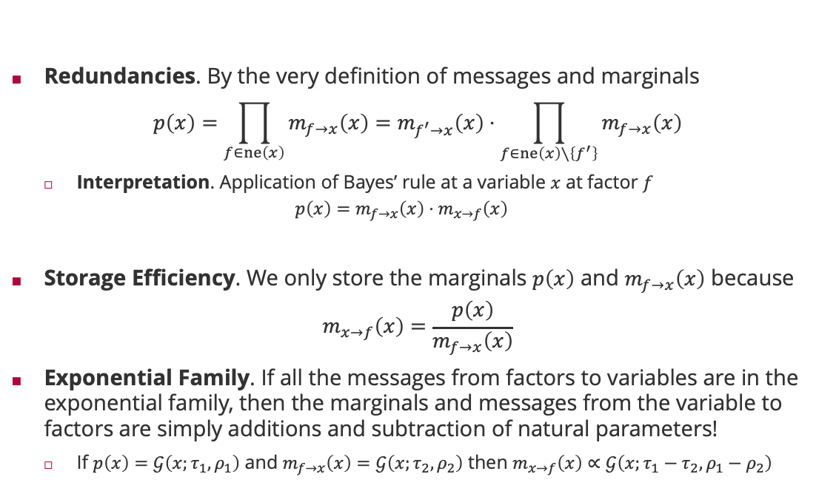

Even more efficiency
Redundancies. By the very definition of messages and marginals
$$p\left(x\right)=\prod_{f∈ne\left(x\right)}{m_{f→x}\left(x\right)}=m_{f^{′}→x}\left(x\right)⋅\prod_{f∈ne\left(x\right)∖\left\{f^{′}\right\}}{m_{f→x}\left(x\right)}$$
Interpretation. Application of Bayes’ rule at a variable $x$ at factor $f$
$$p\left(x\right)=m_{f→x}\left(x\right)⋅m_{x→f}\left(x\right)$$
Storage Efficiency. We only store the marginals $p\left(x\right)$ and $m_{f→x}\left(x\right)$ because
$$m_{x→f}\left(x\right)=\frac{p\left(x\right)}{m_{f→x}\left(x\right)}$$
Exponential Family. If all the messages from factors to variables are in the exponential family, then the marginals and messages from the variable to factors are simply additions and subtraction of natural parameters!
If $p\left(x\right)=𝒢\left(x;τ_{1},ρ_{1}\right)$ and $m_{f→x}\left(x\right)=𝒢\left(x;τ_{2},ρ_{2}\right)$ then $m_{x→f}\left(x\right)∝𝒢\left(x;τ_{1}−τ_{2},ρ_{1}−ρ_{2}\right)$
$$m_{x→f^{′}}\left(x\right)$$
posterior
Likelihood $×$ normalization
prior

Slide 23
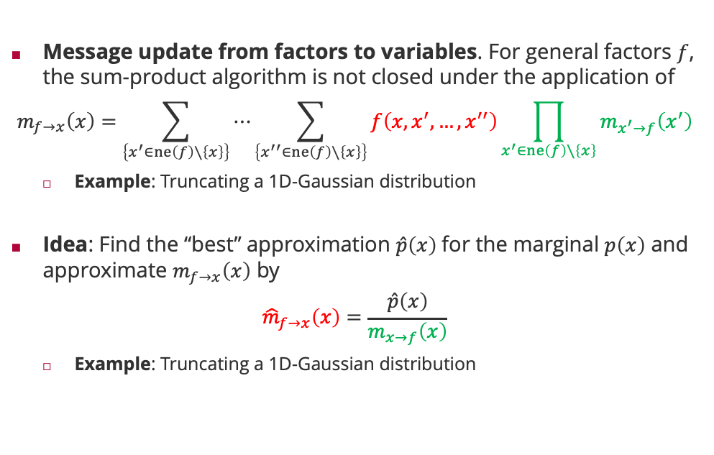
Approximate Message Passing
Message update from factors to variables. For general factors $f$, the sum-product algorithm is not closed under the application of
$$m_{f→x}\left(x\right)=\sum_{\left\{x^{′}∈ne\left(f\right)∖\left\{x\right\}\right\}}{⋯\sum_{\left\{x^{′′}∈ne\left(f\right)∖\left\{x\right\}\right\}}{f\left(x,x^{′},…,x^{′′}\right)\prod_{x^{′}∈ne\left(f\right)∖\left\{x\right\}}{m_{x^{′}→f}\left(x^{′}\right)}}}$$
Example: Truncating a 1D-Gaussian distribution
Idea: Find the “best” approximation $\hat{p}\left(x\right)$for the marginal $p\left(x\right)$ and approximate $m_{f→x}\left(x\right)$ by
$${\hat{m}}_{f→x}\left(x\right)=\frac{\hat{p}\left(x\right)}{m_{x→f}\left(x\right)}$$
Example: Truncating a 1D-Gaussian distribution

Slide 24
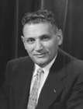
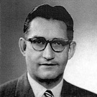
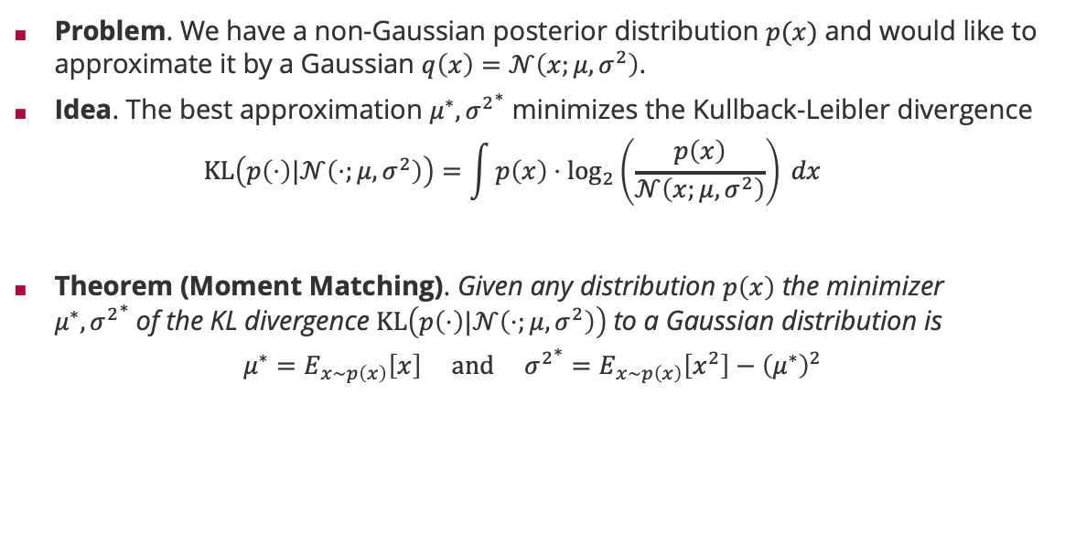
Information Theoretic Approximation: KL Divergence
Problem. We have a non-Gaussian posterior distribution $p(x)$ and would like to approximate it by a Gaussian $q\left(x\right)=𝒩\left(x;μ,σ^{2}\right)$.
Idea. The best approximation $μ^{∗},{σ^{2}}^{∗}$ minimizes the Kullback-Leibler divergence
$$KL\left(p\left(⋅\right)|𝒩\left(⋅;μ,σ^{2}\right)\right)=\int{p\left(x\right)⋅\log_{2}\left(\frac{p\left(x\right)}{𝒩\left(x;μ,σ^{2}\right)}\right) dx}$$
Theorem (Moment Matching). Given any distribution $p\left(x\right)$ the minimizer $μ^{∗},{σ^{2}}^{∗}$of the KL divergence $KL\left(p\left(⋅\right)|𝒩\left(⋅;μ,σ^{2}\right)\right)$to a Gaussian distribution is
$$μ^{∗}=E_{x∼p\left(x\right)}\left[x\right] and {σ^{2}}^{∗}=E_{x∼p\left(x\right)}\left[x^{2}\right]−{\left(μ^{∗}\right)}^{2}$$
Solomon Kullback (1909 – 1994)
Richard Leibler (1914 – 2003)

Slide 25



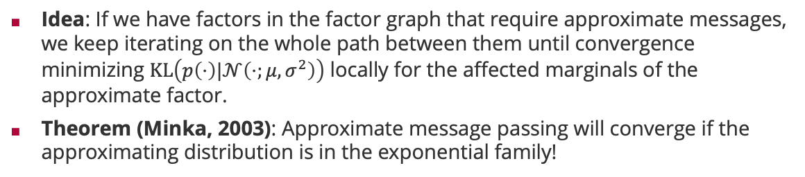



Expectation Propagation
Idea: If we have factors in the factor graph that require approximate messages, we keep iterating on the whole path between them until convergence minimizing $KL\left(p\left(⋅\right)|𝒩\left(⋅;μ,σ^{2}\right)\right)$ locally for the affected marginals of the approximate factor.
Theorem (Minka, 2003): Approximate message passing will converge if the approximating distribution is in the exponential family!
Tom Minka
1
1
1
$$x_{1}$$
$$x_{2}$$
$$x_{5}$$
8
4
7
8
2
5
$$x_{3}$$
$$x_{4}$$
3
6
iterate until convergence

Slide 26
Viel Spaß bis zur nächsten Vorlesung!

